Slide 1
Marketing Research Project
By: Muhammad Saleem & Cristian Utate

Slide 2
Table of Contents
Problem statement and Proposition
Methodology
Assumptions
Top Zip codes with Hispanic Population
Highest income Hispanic Zip codes
Number of competing restaurants
Key takeaways

Slide 3
Problem statement and Proposition
Problem Statement: Problem Statement: A prospective entrepreneur needs help deciding on a new restaurant location in NYC that would earn $100,000.00 / year, while serving the Hispanic community.
Value Proposition: We can determine the best NYC location conducive to a revenue of $100,000.00 / year.

Slide 4
Methodology
In order to determine where in NYC it is more fitting to start a new Hispanic/Latino restaurant, we made 3 few assumptions:
It had to be a neighborhood with a large hispanic/latino population
The higher the income a neighborhood has, the more likely they are to have disposable income
Zip codes with a low number of competing restaurants will be a better environment for a new restaurant
Large Ethnic Hispanic Population
High Income zip codes
Best restaurant location
Neighborhoods with a low number of competing restaurants

Slide 5
Assumption 1: Customers are most likely to eat something they are familiar with
Ethnicity plays a big role in food choice. For this reason, our first assumption is that preference for hispanic/latino food will be highest in neighborhoods of NYC with large Hispanic/Latino populations.
According to researchers at the Imperial College School of Medicine and University College London looking at food choice and ethnicity, “Different ethnic groups will choose and select different foods. This is because people who belong to ethnic groups will have been raised and brought up in a certain style and manner.”
Source: https://ispub.com/IJTWM/1/2/11779

Slide 6
Assumption 2: Higher Income neighborhood means more eating out spending
Households with higher incomes tend to spend more on eating out
According to a University of Minnesota study on household income and its effect on food sources: “higher income households spent more per person from both home and eating out sources compared with lower income households”
Due to this conclusion, we will assume that a higher income neighborhood will be conducive to higher restaurant spending.
Source: https://www.ncbi.nlm.nih.gov/pmc/articles/PMC2988056/

Slide 7
Assumption 3: Places with a lower number of restaurants will have lower competition
Our third assumption is that places with a lower number of restaurants will have lower competition and will therefore make for a better restaurant location

Slide 8
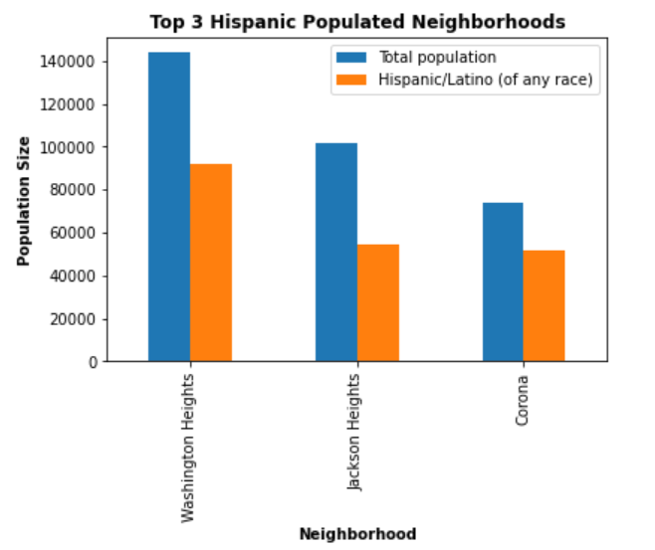
Top 3 Neighborhoods by Hispanic Population
After analyzing 2020 NYC census data, we find that the top 3 Neighborhoods with the largest Hispanic populations are:
Washington Heights in Manhattan
Jackson Heights in Queens
Corona in Queens
All three of these neighborhoods have percentages of people that identify as Hispanic north of 50%

Slide 9
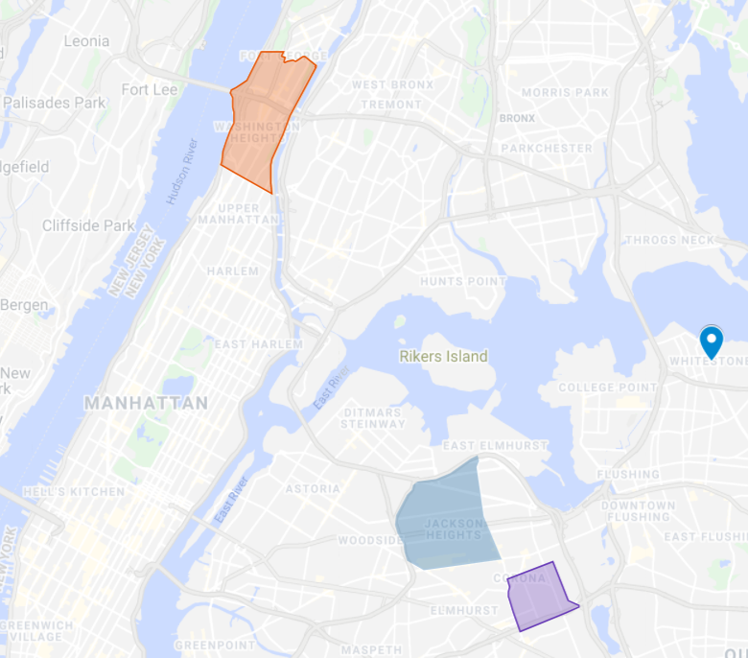
Map of The Top 3 Zip codes by the Hispanic Population
As seen on the map, the 3 neighborhoods with the largest hispanic populations are found in Manhattan and Queens
1. Washington Heights
2. Jackson Heights
3. Corona

Slide 10
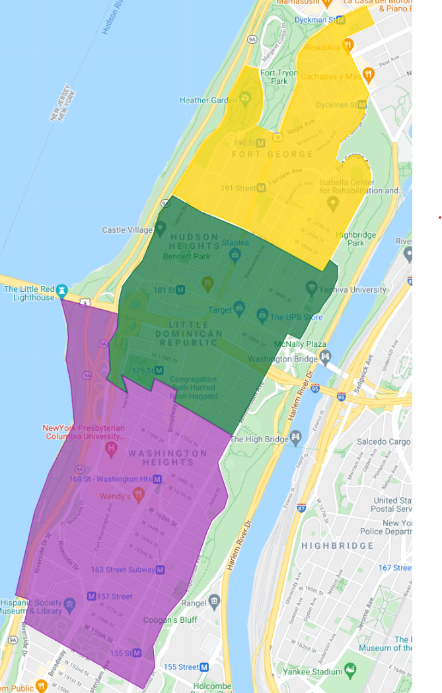
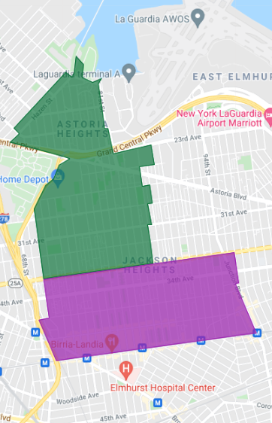
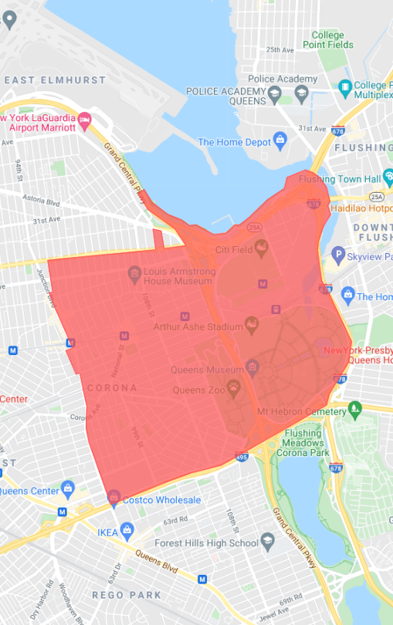
Converting Neighborhoods to Zip Codes
Washington Heights (10033, 10034, 10040)
Jackson Heights (11370, 11372)
Corona (11368)
10034
10033
11370
11370
10032
11372
Size: 1,059.2 acres
Size: 300 acres
Size: 462.74 acres
Because New York City neighborhoods are defined by the city while zip codes are defined by the US Postal Service, we must convert the neighborhoods to zip codes.

Slide 11
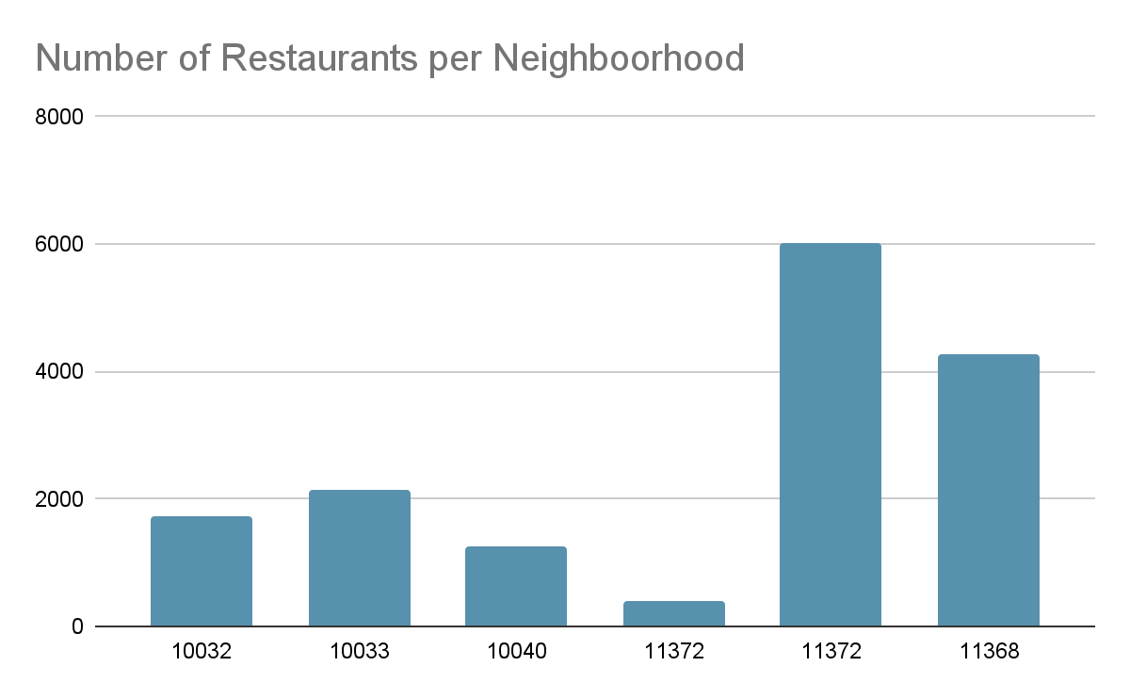
Number of Restaurants by Zip Code in Top 3 Neighborhoods.
Number of Restaurants by Zip Codes:
10032 - 1743 restaurants
10033 - 2140 restaurants
10040 - 1246 restaurants
11370 - 403 restaurants
11372 - 6028 restaurants
11368 - 4261 restaurants
4261
6028
1743
2140
1246
403

Slide 12
Competition Based on Restaurant Density
Washington Heights (10033, 10034, 10040)
Jackson Heights (11370, 11372)
Corona (11368)
10034
10033
11370
11370
10032
11372
4.8
21.4
9.2

Slide 13
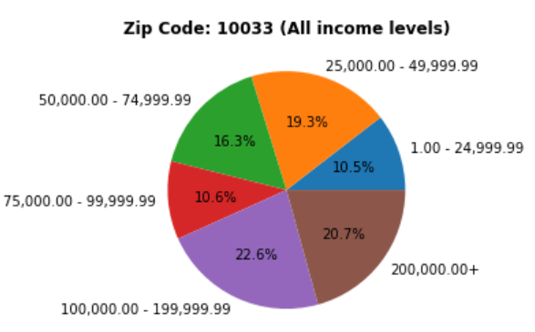
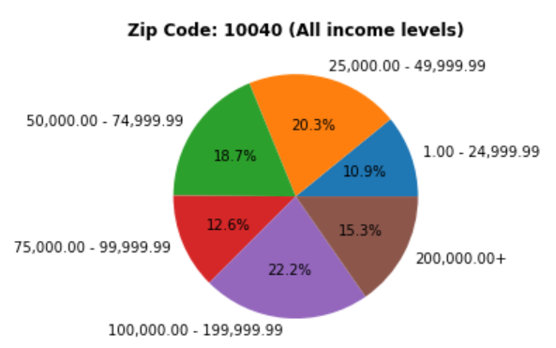
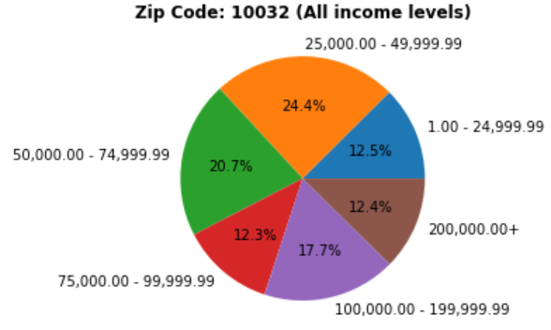
Income breakdown for Zip Codes in Washington Heights
Average Income 75,000+: 48.8% ± 5.9
Income 75,000+: 42.4%
Income 75,000+: 53.9%
Income 75,000+: 50.1%

Slide 14
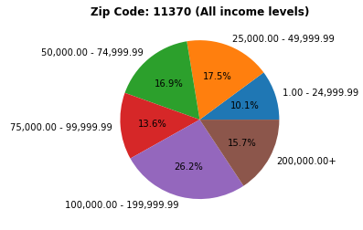
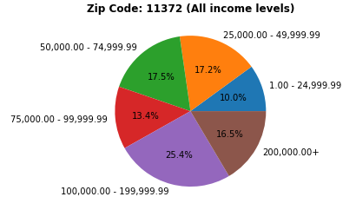
Income breakdown for Zip Codes in Jackson Heights
Average Income 75,000+: 55.4% ± 0.1
Income 75,000+: 55.5%
Income 75,000+: 55.3%

Slide 15
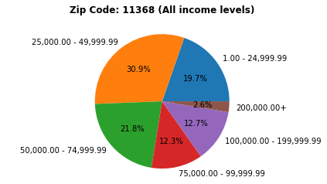
Income breakdown for Zip Code in Corona
The number of individuals with incomes above $75,000 in Zip Code 11368 is 27.6%

Slide 16
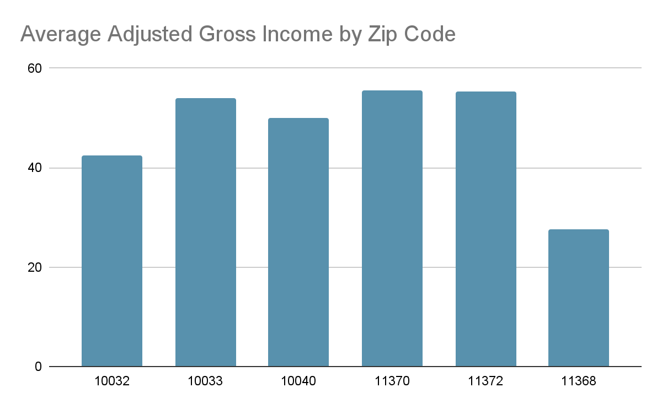
All Zip Codes making up the top 3 neighborhoods ranked by income level 75,000+
Zip Codes:
10032 - 42.4%
10033 - 53.9%
10040 - 50.1%
11370 - 55.5%
11372 - 55.3%
11368 - 27.6%
53.9%
55.5%
55.3%
42.4%
50.1%
27.6%

Slide 17
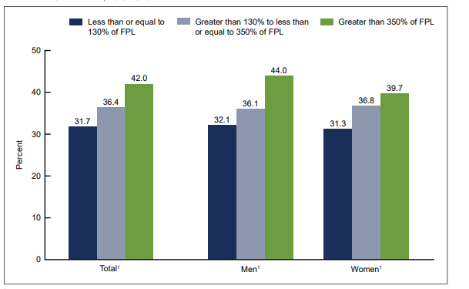
CDC: Daily Fast Food Consumption for Adults Based on Income
Mean ± Standard Deviation: 36.7 ± 5.2

Slide 18
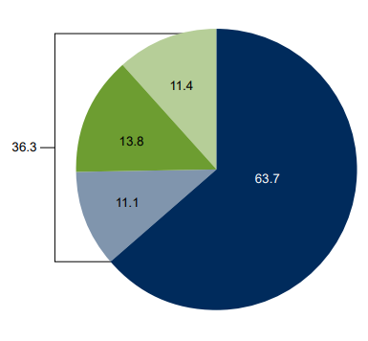
CDC: Fast Food Consumption by Children and Adolescents (aged 2 - 19 years old) on a Daily Basis

Slide 19
Key Takeaways
Out of all the neighborhoods in New York City, there is no overlap between the top 10 wealthiest NYC neighborhoods and the top 10 neighborhoods in terms of Hispanic population.
Although, the average percentage of income earners earning $75,000+ in Jackson Heights is higher than Washington Heights by approximately 6.6%. In regards to income, since at least one-third of people of all family incomes consume fast food, income is not the most important determination to select the best neighborhood to invest a restaurant. Thus, greater emphasis is directed to the other two factors to determine the best location.
Based on the two factors of (1)Size of the Hispanic population, and (2)Having the least competition in terms of restaurant density, Washington Heights, is the best choice to invest a new restaurant serving the Hispanic community.

Slide 20
Recommendations
Perform primary research to collect survey data (to determine revenue expectations) on:
Restaurant sales in each neighborhood.
Restaurant revenue on a daily, monthly, yearly basis.
Average prices for a meal in restaurant.
Use more statistical analysis:
To provide evidence on which neighborhood is better than others.
To provide evidence on which area within the neighborhood is ideal based on competition and revenue earnings of nearby restaurants.

Slide 21
Appendix:
United Hospital Fund Codes: Section03 6/3/04 (nyc.gov)
https://ispub.com/IJTWM/1/2/11779
https://www.ncbi.nlm.nih.gov/pmc/articles/PMC2988056/
New York ZIP Codes List, Map, Demographics, and Shipping (unitedstateszipcodes.org)

